Slide 1
Queueing up
Supplemental reading:
Verificationguide.com
SystemVerilog, UVM

Slide 2
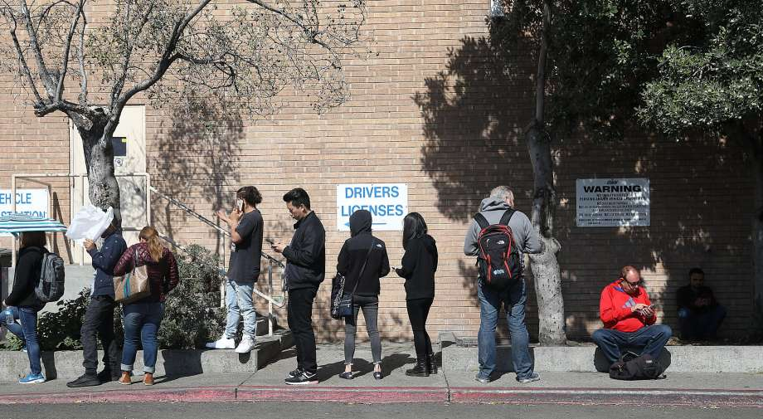

Slide 3
What do Queues Have to With UVM?
Mailbox: access restricted to front and back
Uses semaphores to control access
Built-in class around a queue
Queue: random access supported, as well
Use: passing data sequences between elements within the overall test bench structure

Slide 4
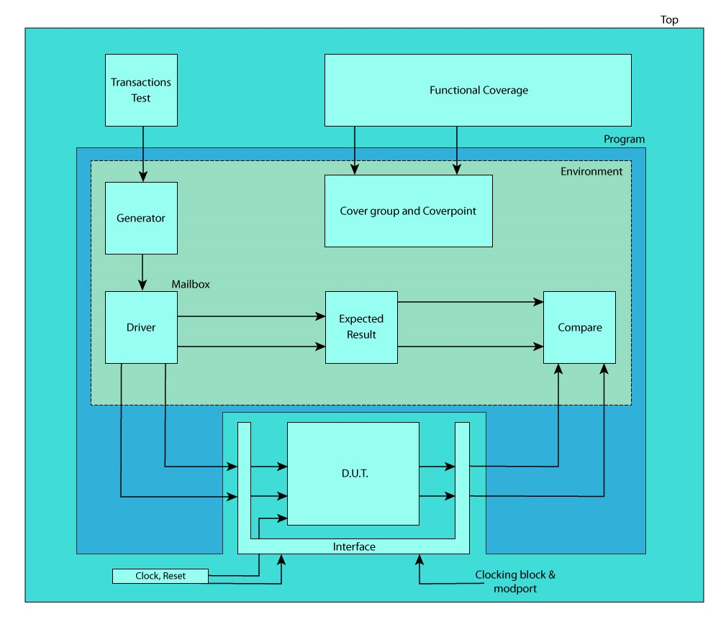
FIFO/Queue/Mailbox use: pass data sequences between test bench elements

Slide 5
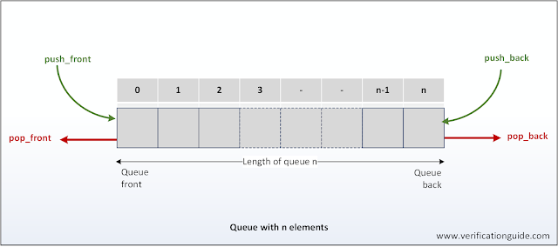
Unbounded Queue

Slide 6
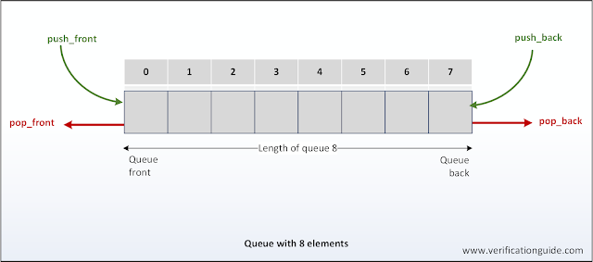
Bounded Queue

Slide 7
Queue Methods
size() | returns the number of items in the queue
insert() | inserts the given item at the specified index position
delete() | deletes the item at the specified index position
push_front() | inserts the given element at the front of the queue
push_back() | inserts the given element at the end of the queue
pop_front() | removes and returns the first element of the queue
pop_back() | removes and returns the last element of the queue

Slide 8
See example queues_array

Slide 9
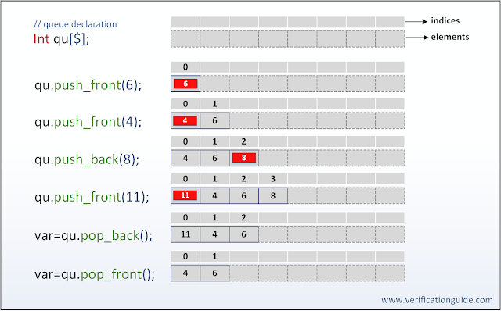
Queue push & pop methods

Slide 10
See queues_array_pp example

Slide 11
Random access methods
Demo: queues_array_ra
insert(index,value):
Overwrites current contents at position index with new value
random read: just use temp=queue[index];
Uses include image processing
Raw image may be loaded in raster sequence, but need random access to break into 8x8 pixel blocks for DCT and rest of JPEG/MPEG compression
Compressed image may be loaded in reconstructed 8x8 pixel blocks, needs to be turned back into a raster sequence for display on monitor

Slide 12
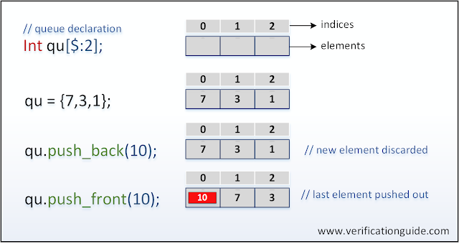
Bounded queue
push_back to full queue: no impact
Push_front to full queue: delete last entry, store new entry to [0]

Slide 14
spares

Slide 15
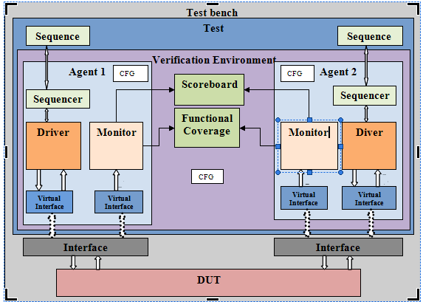
Each arrow between blocks represents a queue

